Slide 1
Demand

Slide 2
Learning Objectives Checklist
Law of Demand
Three reasons for the downward slope of the demand curve
Market Demand
Demand and Utility
Change to Demand
Movement vs Shift
Determinants/shifters of demand
Normal vs Inferior Goods
Substitutes and Complements

Slide 3


Meaning of demand
In non-economic terms, demand means how much we want something.
In more economic terms, demand refers to the how much a buyer is willing to pay for a good or service.
Summary
Demand represents our willingness to pay for something.

Slide 4
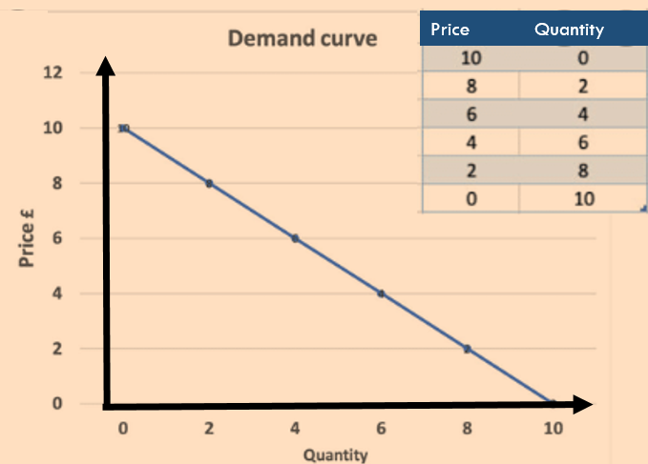
The Law of Demand
The lower the price the more people will buy of something.
There is a negative/inverse relationship between the price of a good and the quantity bought.
The demand curve slopes down.
Definition: Demand
The quantity of a product or service that consumers are willing and able to buy at a particular price.
Summary: Law of Demand
Price goes down, people buy more

Slide 5

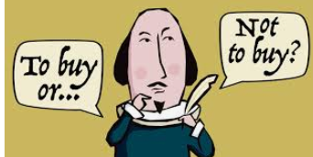
Law of Demand Example
Would you buy a pair of air pods for 3000RMB?
Would you buy a pair for 1999RMB?
Would you buy a pair for 999RMB?
Would you buy a pair for 200RMB?
Price | Quantity
3000
1999
999
200

Slide 6
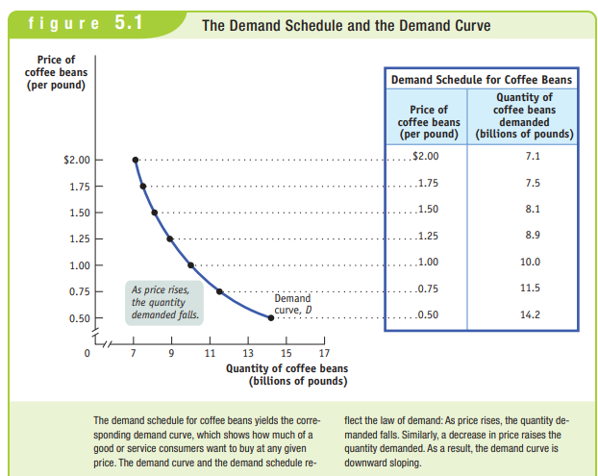
Demand Schedule and Demand Curve
A demand schedule is a table that shows different prices and the quantities that we will buy.
This shows the willingness to pay for that good.
These points can be represented on a graph and is called a demand curve.
Note that some people have a higher willingness to pay than others.
Demand curve
Demand schedule
Summary
We can represent in a table or on a graph, people’s different willingness to pay for a good.

Slide 7
What is the law of demand?
There is a negative relationship between price and quantity for consumers.
Ie. When the price is low, people buy more.
The demand curve is downward sloping

Slide 8

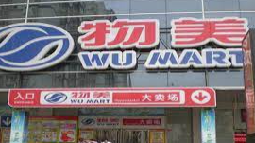


What is a market?
Summary
A market is a space where buyers and sellers come together to transact. ALL the buyers. ALL the sellers.
A market is where buyers and sellers come together and transact on goods and services.
Markets have always had a physical meaning where many different sellers could set up shop and consumers knew where to go to buy certain goods.
Increasingly markets are becoming more and more spread out and connected (or even replaced!) by technology.
When we talk about a market, we are often referring to the whole country (China), region (Asia) and even the globe!

Slide 9
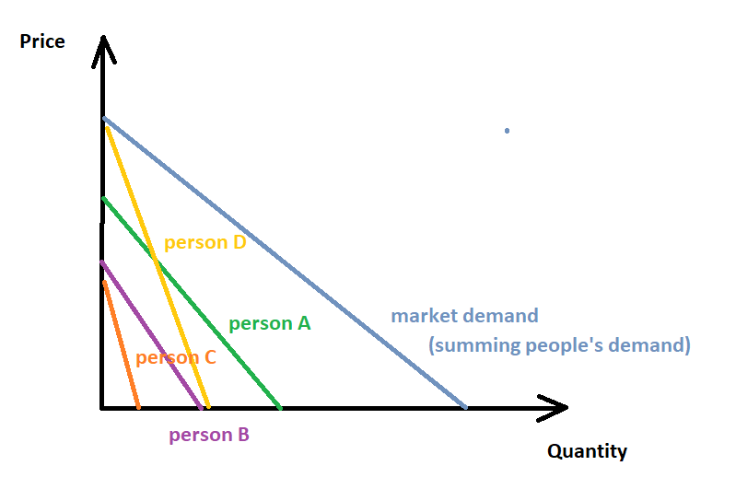
Individual demand vs. market demand
Every individual has an individual demand for a product.
When we add these individual demand curves together horizontally we arrive at the market demand.
Summary
Market demand is individual demand horizontally summed.

Slide 10
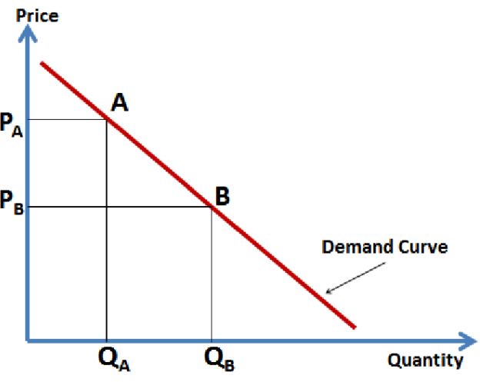
Drawing the Demand Curve
Market for ____________
Labels
Market for ________ Chocolate, Movies, Shoes etc.
Axes
Y axis – price (P)
X axis – quantity (Q)

Slide 11

Activity
Draw a demand curve for a good such as taxi rides in Beijing. (Don’t worry too much about the exact shape of the curve.)
D

Slide 12
Demand and Utility

Slide 13

Utility
Economics is all about measuring utility. What is utility?
Utility is a fancy term for benefit/satisfaction that we receive from an event, product or decision.
If something has high utility it means it gives a large amount of benefit.
Of course everyone is different, so some of us get more/less benefit from the same things!
Eg. You may love playing sport or reading but others may not.
Utility =
What are some things that give you lots of benefit?
Icecream, reading a book, watching a movie, laughing with friends, seeing family, getting a good grade in an exam

Slide 14
What is utility?
It is the benefit/satisfaction that one receives from a decision, product or event.

Slide 15


Willingness to Pay and Utility
Willingness to pay is determined by the utility/benefit we receive from the good/service.
The higher the utility we receive, the higher our willingness to pay of something.
We do not want to pay more than the utility we receive.
Eg. If a move ticket gives you $15 of utility, you would only pay $15 or less.
If you love something, your utility and willingness to pay is high.
If you hate something, your utility is low or even negative. You may not want to pay any money at all!
Summary
When you have high utility from a good/service, you will have a higher willingness to pay.

Slide 16
If your friend loves salty chips but you don’t like salty snacks very much, who has a higher willingness to pay?
Your friend

Slide 17

Note: Ineffective demand is when desire is not backed by the purchasing power (i.e., when the buyer cannot afford to buy the good or service). For example, many consumers might demand a fancy yacht, but do not have the financial means to purchase it. Effective demand is where you have the desire and the ability to pay.

Slide 18
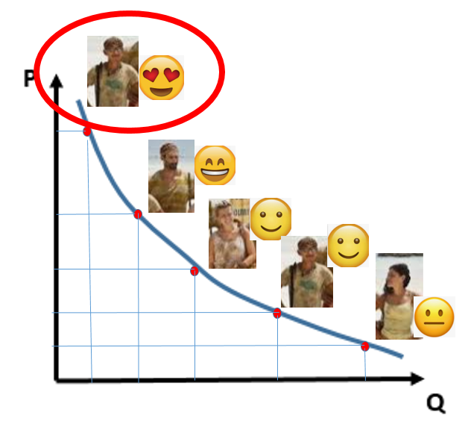
Left part of the demand curve vs right part of the curve
Link – full explanation of demand
When we read from the x axis upward, we see that we are measuring the different utility/willingness to pay of different consumers – demand is simply a utility curve
As we start at the left where the demand curve is the highest, this shows consumers with the highest utility. They will pay a higher price.
As we move to the right, each successive unit goes to people who love the product less and less ie. have lower utility. They will not pay as high a price.
Willingness to pay/Utility curve
Summary
Demand is a utility curve.
Left/top of curve = higher utility
Right/bottom of curve = lower utility

Slide 19


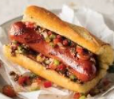

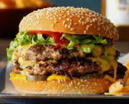
Survivor Auction – Different Levels of Utility
Survivor is a show where people must live on an island without the things they would usually have. No electronics, no normal food etc.
Sometimes on the show, they would hold an auction where people could buy normal things.
What do we notice about who gets what items?
Summary
In this show the food went to the people with the highest utility.
They had the highest willingness to pay.
Survivor Australian Outback Auction - YouTube

Slide 20

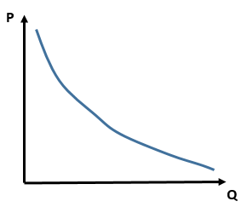







All the contestants may like pancakes, but some contestants may have higher utility and a higher willingness to pay for the only pancake!
So the demand curve for pancakes may look a bit like this.
Of course, when there is only one pancake, it will go to the highest bidder!
Highest Willingness to pay
Note:
The 2nd pancake of the person who loves pancakes, could be higher than the utility of someone’s first pancake.

Slide 21
In the video there was only one chocolate available!
So in this case, it will go to the highest bidder!
This will be the person with the highest utility/willingness to pay!
Highest Willingness to pay

Slide 22
Utility/benefit
Willingness to pay
consumers
The demand curve shows the ___________ that _____________ receive from the product.
Consumers on the left/top part of the demand curve have __________ utility from the good and so they will pay a __________ price.
Consumers on the right/bottom part of the demand curve have __________ utility from the good and so they will pay a __________ price.
higher
higher
lower
lower

Slide 23
Bonus: What happens if we have no money? Ineffective Demand
If we measure demand and willingness to pay with money, what happens if someone wants something but has no money?
Ineffective demand is when desire is not backed by the purchasing power (i.e., when the buyer cannot afford to buy the good or service).
For example, many consumers might demand a fancy yacht, but do not have the financial means to purchase it. Effective demand is where you have the desire AND the ability to pay.
What is meant by demand and what makes it “effective”?
Effective demand refers to how much a buyer is willing AND able to purchase at a given price. Without enough money it is ‘ineffective demand’.
Summary
Ineffective demand is demand that is not backed up by money.
Effective demand = willingness to pay AND ability to pay

Slide 24
Demand Curve Summary
Utility is the benefit we receive from a good/service.
Law of demand – the demand curve slopes downward.
Lower price = higher quantity bought
Price – y axis, Quantity – x axis
The market demand curve is made up of many consumers. (We add the curves together)
The demand curve shows the willingness to pay of consumers.
Higher utility = higher willingness to pay
Shown on the top part of the demand curve

Slide 25
More on Understanding the Demand Curve

Slide 26

Three Reasons for the Law of Demand
We have established the law of the demand – the demand curve slopes down!
There are three reasons for this.
1. Diminishing Marginal Utility
2. The Income Effect
3. The Substitution Effect
Summary
We know that the demand curve slopes down – the law of demand. But there are three explanations for this.

Slide 27
Reason 1: Diminishing Marginal Utility

Slide 28
Utility Revision
Utility is a fancy term for benefit/happiness/positivity that we receive from an event, product or decision.
Utility =

Slide 29

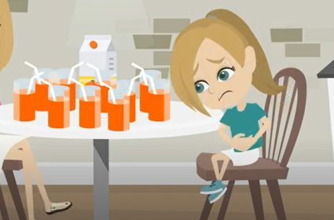
1. Diminishing Marginal Utility
Diminishing = getting smaller and smaller
Marginal = from the last unit
You will see the term marginal a lot in economics.
It always means ‘the last one’ eg. the last thing we produced, the last dollar we received
Utility = happiness, benefit etc.
Marginal utility = how much benefit/happiness you get from the last unit.
Note: Marginal Utility can become negative. Imagine eating 10 pizzas… the last pizza may actually make you feel sick (negative benefit)!
Link

Slide 30
What is diminishing marginal utility? Give an example.
You play video games. The first hour is the most fun and it gets less fun as time passes, even though it may still be a lot of fun. If you play for 10 hours straight, the final hour may even give you negative utility.
Donut Torture

Slide 31





Reason 2. Income Effect
Reason 3. Substitution Effect
When the price of a good falls, this means that you have more spare money
So you can buy more of ALL Goods
Eg. The price of electricity falls so you have an extra $200 per month which you can now spend on anything, including that good! Eg. clothes, food etc.
When the price of a good falls, people have a tendency to buy more of the cheaper good and less of the more expensive good.
Eg. If the price of oranges falls, people will buy fewer of the more expensive apples and substitute with more oranges.
When the price of any good falls, your income is now higher so you buy more of everything!
When the price of any good falls, you buy more of that good compared to other goods!

Slide 32
What are the three reasons why the demand curve slopes downwards?
Diminishing marginal utility
Income Effect – you can buy more of all goods
Substitution Effect – you buy more of the cheaper good and less of the other goods

Slide 33
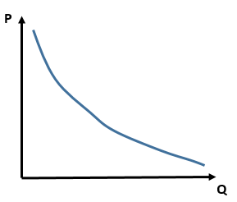
Movements ALONG the Demand Curve
Change in price moves us along the demand curve
Increase of price moves to the right/up
Decrease of price causes extension
We have established the law of demand which shows a downward sloping curve.
Therefore, any change of price moves us along the curve.
Price increase moves us left along the curve – contraction ie. quantity decreases
Price decrease moves us right along the curve – extension ie. quantity increases

Slide 34

Movements of the Demand Curve
Some factors increase demand by shifting the curve right.
Others reduce demand and shift the curve left.
The demand curve can often shift to the left and right depending on changes to different factors called shifters or ‘determinants of demand’.
What does the shift mean?
A rightward shift means that at all prices, people will buy a higher quantity.
A leftward shift means that at all prices, people will buy a lower quantity.
What happens if a product becomes more popular? Eg. Canada Goose Jackets
At any given price, will people buy more or less?
Answer: More!
D₁
D₁
D₀

Slide 35
Determinants of Demand / Shifters of Demand
Demand shifters or the ‘determinants of demand’ are the factors that will move the whole demand curve to the left or right.
These factors can include things such as:
Population
More consumers means more units sold ie. rightward shift
Popularity
Increases in popularity increase sales ie. rightward shift
Expectations of price
If you expect the price to increase you will buy more today ie. rightward shift
Factors such as increase in population means more consumers →higher quantity sold

Slide 36
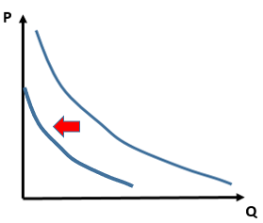
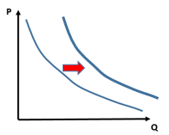
Determinants of Demand - Effects
Determinants of Demand | Increase | Decrease
Popularity and advertising | Demand shifts to the right → | Demand shifts to the left←
Population size | Demand shifts to the right → | Demand shifts to the left←
Taste, fashion, season | Demand shifts to the right → | Demand shifts to the left←
Income of consumers | Demand shifts to the right → | Demand shifts to the left←
Expectations of Price | Demand shifts to the right → | Demand shifts to the left←
Tax on a good | Demand shifts to the left← | Demand shifts to the right →
Import tax | Demand shifts to the left← | Demand shifts to the right →

Slide 37
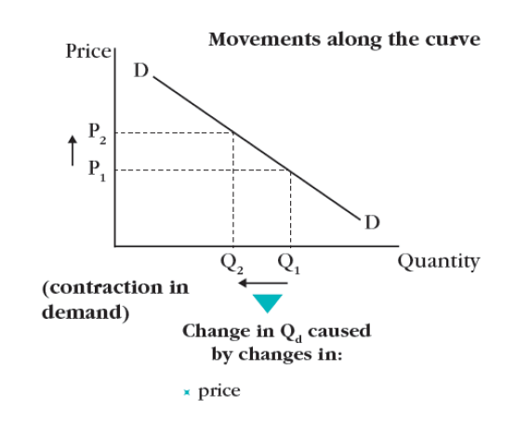
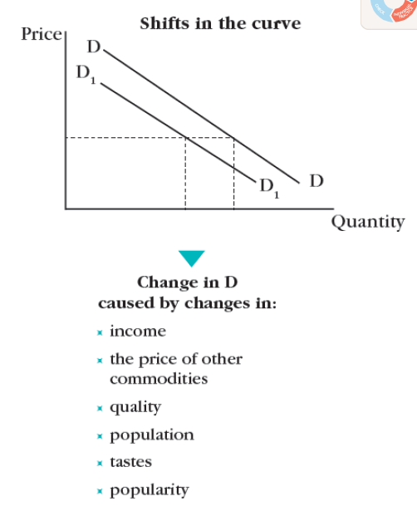
Price change
Non-Price Factors
Movements along the SAME curve – “change in quantity demanded”
Movements of the WHOLE curve left and right – “change in demand”
Determinants of Demand
Contraction
Extension
Also called:
Determinants of demand
Summary:
Change of price – movement along curve (but the curve itself doesn’t move)
Change in other factors – curve moves left or right (determinants of demand)

Slide 38
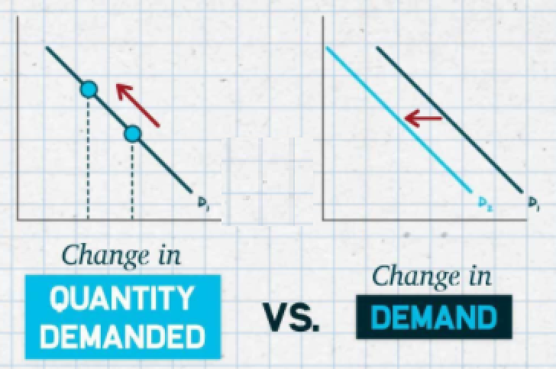
What happens to the demand curve if there is a change of price?
The demand curve does not shift, but there will be a movement along the SAME demand curve.
What happens to the demand curve if there is a change in another factor such as the number of consumers increasing.
The demand curve will shift left or right. In this example it will shift to the right.

Slide 39

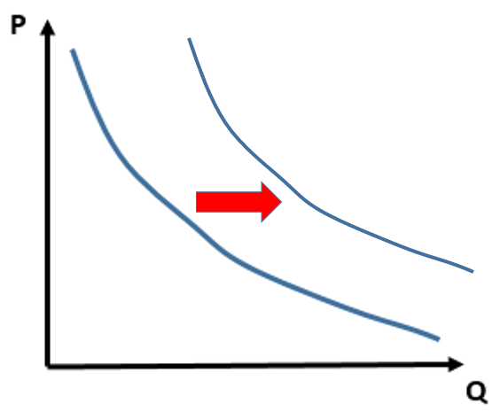
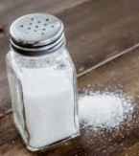
More Determinants of Demand - Effect of Income
INFERIOR GOODS
An inferior good/service will be purchased
less when people have more income because they can now afford to buy better quality goods/services.
Eg. Public transport
When people’s income increases, they choose:
taxis
rental car
buy a car etc.
Disposable income is the total personal income of a worker/consumer minus income tax – how much they have to spend.
NORMAL GOODS
When incomes rise, normal goods see an increase in demand.
Eg. People buy more holidays to Europe when their income rises.
Many goods follow this pattern but not all.
SMALL PROPORTION OF INCOME GOODS
For some goods, income has little effect on the quantity consumed such as goods/services that require a small portion of an individual’s income. Eg. salt
Even if your income increases or decreases, because salt is such a basic good and a small amount of our income, we would continue to buy the same amount.
Inferior goods : higher income = buy less
Normal goods : higher income = buy more
Small proportion of income goods = no effect

Slide 40
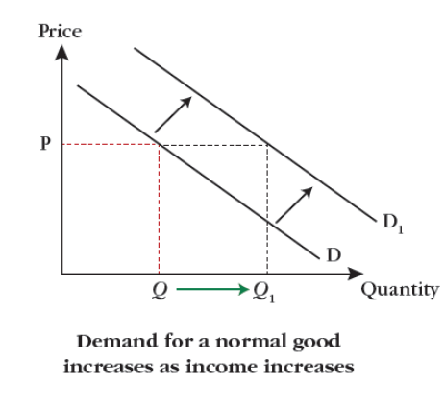
By using a graph, illustrate and explain the effect of an increase in income on a normal good and on an inferior good.

Slide 41









Substitutes vs Complements
Summary
Substitutes – you buy one or the other. ↑Price_{good X} → ↑Demand_{goodY}
Complements – bought together
Substitutes
A substitute is a product that can be purchased and used instead of another good. (competitive demand)
Example: Gas vs electric hotplates, Coke vs Pepsi
Complements
Complements are purchased together (joint demand)
Eg. Computers and a computer mouse, beer and peanuts, phones and phone apps.
↑Price of substitute → ↑Demand
↑Price of complement → ↓Demand

Slide 42
Substitutes and Complements effect on demand?
Price of oranges increases. Effect on apples?
Demand for apples will increase (substitutes)
Demand of golf clubs increases. Effect on golf balls?
Demand for golf balls will increase (complements)
Price of cars increase. Effect on public transport use?
Demand will increase (substitutes)
In groups come up with a list of 3 complement pairs and 3 substitute pairs.
Note: If the price increases because of increased demand, then that will have a different effect than if it rises for another reason.

Slide 43
Determinants of Demand - Effects
Determinants of Demand | Increase | Decrease
Popularity and advertising | Demand shifts to the right → | Demand shifts to the left←
Population size | Demand shifts to the right → | Demand shifts to the left←
Taste, fashion, season | Demand shifts to the right → | Demand shifts to the left←
Incomes (for a normal good) | Demand shifts to the right → | Demand shifts to the left←
Expectations of Price in the future | Demand shifts to the right → | Demand shifts to the left←
Price of a substitute | Demand shifts to the right → | Demand shifts to the left←
Price of a complement | Demand shifts to the left← | Demand shifts to the right →
Demand of a complement | Demand shifts to the right → | Demand shifts to the left←

Slide 44
Determinants of Demand - Effects
Determinants of Demand | Increase | Decrease
Popularity and advertising | Demand shifts to the right → | Demand shifts to the left←
Population size | Demand shifts to the right → | Demand shifts to the left←
Taste, fashion, season | Demand shifts to the right → | Demand shifts to the left←
Incomes (for a normal good) | Demand shifts to the right → | Demand shifts to the left←
Expectations of Price in the future | Demand shifts to the right → | Demand shifts to the left←
Price of a substitute | Demand shifts to the right → | Demand shifts to the left←
Price of a complement | Demand shifts to the left← | Demand shifts to the right →
Demand of a complement | Demand shifts to the right → | Demand shifts to the left←

Slide 45
Show graphically the impact of the following changes on the demand for chocolate boxes:
Consumers’ incomes rise by 20%.
Demand for a chocolate substitute that helps with weight loss, increases.

Slide 46
Supply

Slide 47
Learning Objectives Checklist
Law of Supply
Market Supply
Supply and Cost
Change to Supply
Movement vs Shift
Determinants/shifters of supply
Substitutes and Complements

Slide 48
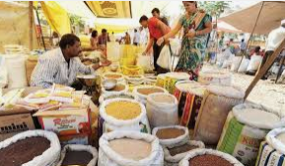

Supply
Demand – how much consumers want to buy
Supply – how much suppliers want to sell
Supply refers to the quantity sellers are prepared to offer for sale at a specific price and at a certain time.
Unlike the law of demand (inverse relation between price and demand), the law of supply states that the higher the price, the higher the amount supplied (a positive relationship). This is intrinsic to the profit motive.

Slide 50
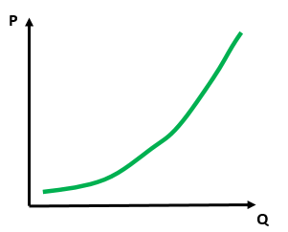
Law of Supply
As we have now learned, supply is from the perspective of producers.
The law of supply is the opposite of the law of demand.
The higher the price, the higher the quantity that producers will sell.
There is a positive relationship between price and quantity.
Your Pizza Restaurant
Supply
Law of supply – the higher the price the larger the quantity supplied by producers

Slide 51
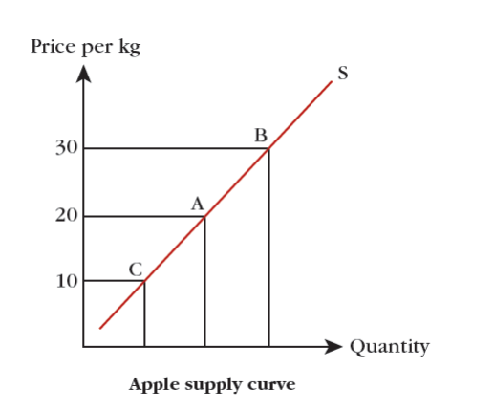

Slide 52
What is the law of supply?
There is a positive relationship between the price and the quantity.
Ie. When the price is high, producers will produce and sell more units.

Slide 53


Why does supply really slope upwards? Scarcity
Note: the cost is not always increasing, but EVENTUALLY it will.
As you produce more and more, eventually the cost per unit gets higher and higher.
The units produced at the left of the curve will generally have a lower cost of production because the resources are less scarce.
Eg. Land is plentiful
Qualified workers are easy to find
There are plenty of machines available to produce
The units produced at the right/top of the curve have a higher cost of production because scarcity starts to kick in.
Eg. the good land has already been used
All the qualified workers are already working elsewhere
All the machines you want are sold out etc.
10
100
Supply is a cost curve.
The price of production gets higher and higher because of scarcity. Suppliers charge a higher price.
The 10th unit costs $x but the 100th unit costs much more!

Slide 54
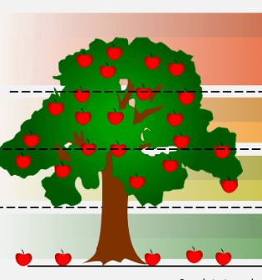
The low hanging fruit and fruit on the ground is the easiest to harvest but once these have been picked it becomes increasingly resource intensive to pick the more apples.

Slide 55
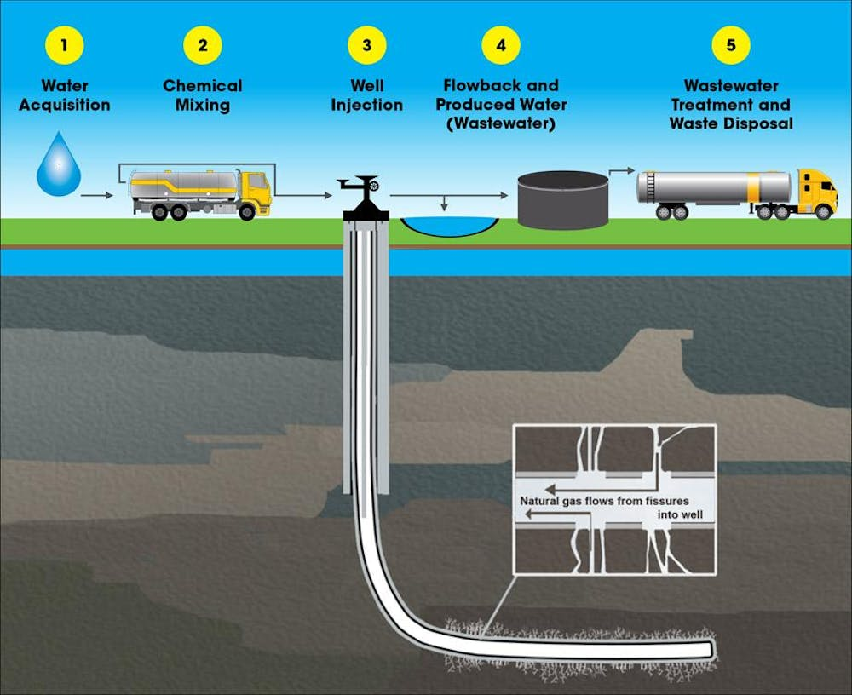
As we source more oil, we need increasing levels of capital to be able to access the oil further from the surface.

Slide 56
Cost and Willingness to Sell
Demand is associated with willingness to pay/utility
A buyer will only buy goods at a price that is equal or lower than their utililty
Supply is associated with willingness to sell/cost
A seller will only sell goods for a price that is higher than their cost to produce
This is their willingness to sell

Slide 57
cost
producers
The supply curve shows the ___________ that _____________ must incur to produce the product.
Units on the left/bottom part of the supply curve have a __________ cost to produce the good and so they will be willing to sell for a __________ price.
Units on the right/top part of the supply curve have a ________ cost of production for the good and so sellers will only sell for a __________ price.
Lower
lower
higher
higher

Slide 58
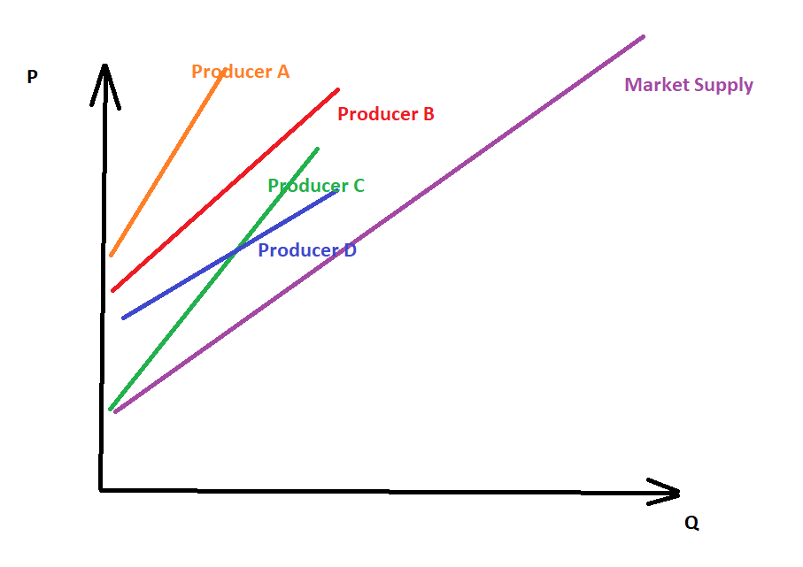
Market Supply
Similar to demand, the market supply adds the supply curves of all the producers
Market For Good _____
Note: Similar terms
Producer
Supplier
Seller
Firm
Business
Ie. the ones who make the products

Slide 59
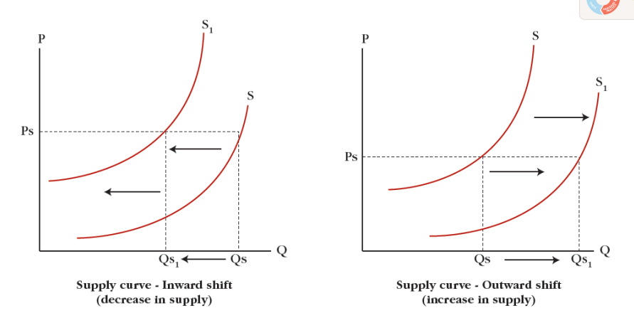
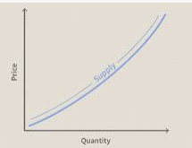
Change of Price
“change in quantity supplied.”
Non-price factors – Determinants of Supply
These factors will increase or decrease the production, even if the price doesn’t change.
Therefore they cause a rightward or leftward shift of the supply curve
“change in supply.”
Higher price – a supplier will supply more.
Lower price – a supplier will supply less.
A supplier will move up and down the same curve based on the price offered.
Extension
Contraction
Non-price factor examples
Price of resources/factors of production (eg. wages, oil price)
Number of producers in the market
Efficiency of production and productivity (eg. more skilled workers)
Technology
Expectations of sales
External factors
tax subsidies
financial grants
Weather etc.
Summary
Price – causes a movement
Other factors – shifts the curve.

Slide 60


Non-price factors – Determinants of Supply
Link
A supplier’s decision about how much to supply is not only affected by the price of the good/service, but also by other non-price factors. Supply determinants (i.e., non-price factors) result in a total shift of the supply curve.
Cost of factors of production: These include the costs of raw materials, rent, wages, and interest on business loans. The higher the costs incurred by production, the lower the supply.
Efficiency of production and productivity: By making fewer mistakes in the production process and minimizing the wasted resources, suppliers can increase the amount supplied at each price. Productivity also increases the supply since each factor of production results in a higher output.
Number of producers: More producers in the market will increase supply.
Technology implemented: Innovations in machines allow producers to increase their supply and reduce their costs. This also contributes to higher efficiency and productivity. Productivity refers to the output produced by each factor of production. If, for example, a business buys a highly advanced machine that can produce three times more than other machines, and in less time, supply and the output per machine increase.
External factors: Changes in weather conditions or government policies affect supply. The government may, for instance, tax the business’s profit, leaving suppliers with less money, fewer resources, and thus less to supply. However, subsidies are considered as financial grants provided by the government to suppliers and result in higher capital and supply.

Slide 61
Note: Think of supply shifting left and right. A shift to the right means an increase in quantity, therefore increase in supply.
A shift to the right DOES NOT mean a shift downwards, so don’t get confused and think this is a decrease in supply.

Slide 62
What effect does a change in price have on the supply of a good?
Any change in price causes a change in the quantity supplied along the SAME supply curve, ceteris paribus.
Ceteris paribus = keeping all other things equal ie. ‘freezing’ everything else so that you can examine the effect of one variable
Give three reasons that could cause an increase in supply.
technological advances,
a decrease in the costs of resources such as fuel
favorable external conditions such as weather.

Slide 63

Bonus: Ceteris Paribus
Example – ‘Ceteris paribus, an increase in price will cause an increase in quantity supplied.’
This means we should keep the size of the business, skill of workers, type of goods sold to be the same. If we do this, then the statement will be true.’
What is ‘ceteris paribus’?
It is a Latin expression which is also the language for abbreviations such as eg. = exempli gratia or ie. = id est
Ceteris paribus means ‘holding all else equal’
This is useful in situations where we want to analyze the effect of just one variable/factor.
If too many variables are changing then this is not a ‘good experiment’ and we will not be able to see the effect of the one variable.
Ceteris paribus is an important idea because it is needed to analyze a factor. It is therefore very important in scientific subjects.

Slide 64
Explain how each of the following might affect the supply curve:
During a bad winter, Britain’s vegetable farmers complain that they cannot harvest their vegetables from the frozen soil.
Supply curve will shift left
Cote d’Ivoire, the world’s largest producer and exporter of cocoa, sees an increase in civil unrest which leads to some major highways being closed down.
Supply curve will shift left

Slide 65
C) Many governments increase the subsidies they have given to green transport companies.
The supply curve will shift to the right.
d) The number of firms in an industry increases.
The supply curve will shift to the right.

Slide 66

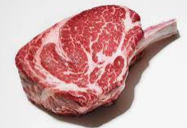

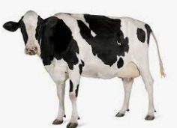
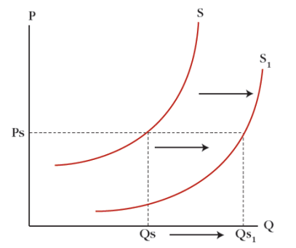

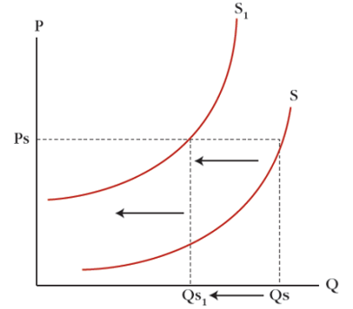

Complements and Substitutes in Production
Complements in production
Complements in production are the result of joint production.
This is where one good is a byproduct of another good.
Eg. Beef and leather.
To make beef/meat you have to kill the cow, which also has skin.
The skin from the same cow is used to make leather, and is produced at the same time as the meat
If we change the meat production, we will naturally change the leather production
Substitutes in production
Substitutes in production are the result of competitive production.
This is where producers have to choose to make one product or another.
Eg. Oil used for jet fuel or plastic toys
Oil can be used to make plastic products or for jet fuel
The choice is made to make one or the other
If we produce more of one good we will produce less of the other.

Slide 67

Determinants of Supply
Determinants of Supply | Increase | Decrease
Input Costs eg. raw material cost and wages | Supply shifts to the left← | Supply shifts to the right →
Efficiency in production | Supply shifts to the right → | Supply shifts to the left←
Productivity | Supply shifts to the right → | Supply shifts to the left←
Corporate Taxes | Supply shifts to the left← | Supply shifts to the right →
Subsidies | Supply shifts to the right → | Supply shifts to the left←
Technology | Supply shifts to the right → | Supply shifts to the left←
Expectations of Future Sales (eg. Halloween costumes) | Supply shifts to the right → | Supply shifts to the left←
Quantity produced of a substitute of production | Supply shifts to the left← | Supply shifts to the right →
Quantity produced of a complement of production | Supply shifts to the right → | Supply shifts to the left←

Slide 68
Determinants of Supply
Determinants of Supply | Increase | Decrease
Input Costs eg. raw material cost and wages | Supply shifts to the left← | Supply shifts to the right →
Efficiency in production | Supply shifts to the right → | Supply shifts to the left←
Productivity | Supply shifts to the right → | Supply shifts to the left←
Corporate Taxes | Supply shifts to the left← | Supply shifts to the right →
Subsidies | Supply shifts to the right → | Supply shifts to the left←
Technology | Supply shifts to the right → | Supply shifts to the left←
Expectations of Future Sales (eg. Halloween costumes) | Supply shifts to the right → | Supply shifts to the left←
Quantity produced of a substitute of production | Supply shifts to the left← | Supply shifts to the right →
Quantity produced of a complement of production | Supply shifts to the right → | Supply shifts to the left←

Slide 69
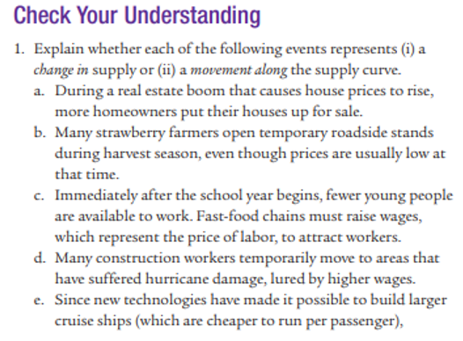

Module 6 Check Your Understanding
A) movement along
B) change in supply – increase
C) change in supply – decrease
D) movement along (this is from the perspective of workers who supply their labor)
E) change in supply - increase

Slide 70
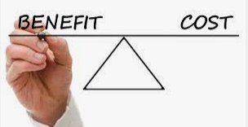
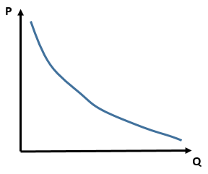
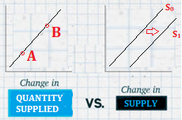
Demand and Supply Comparison
Demand
Shows the utility/benefit to consumers of each unit
Demand is a utility curve which shows willingness to pay
Slopes downward – Law of Demand
Supply
Shows the cost to producers of each unit
Supply is a cost curve
Slopes upward – Law of Supply
For both:
Change of price moves along the same curve
Change of other factors causes movement of the curve (left or right)

Slide 71
Determinants of Demand - Effects
Determinants of Demand | Increase | Decrease
Popularity and advertising | Demand shifts to the right → | Demand shifts to the left←
Population size | Demand shifts to the right → | Demand shifts to the left←
Taste, fashion, season | Demand shifts to the right → | Demand shifts to the left←
Interest Rate | Demand shifts to the left← | Demand shifts to the right →
Expectations of Price | Demand shifts to the right → | Demand shifts to the left←
Incomes (for a normal good) | Demand shifts to the right → | Demand shifts to the left←
Price of a substitute | Demand shifts to the right → | Demand shifts to the left←
Price of a complement | Demand shifts to the left← | Demand shifts to the right →

Slide 72
Determinants of Supply
Determinants of Supply | Increase | Decrease
Input Costs eg. raw material cost and wages | Supply shifts to the left← | Supply shifts to the right →
Efficiency in production | Supply shifts to the right → | Supply shifts to the left←
Productivity | Supply shifts to the right → | Supply shifts to the left←
Corporate Taxes | Supply shifts to the left← | Supply shifts to the right →
Subsidies | Supply shifts to the right → | Supply shifts to the left←
Technology | Supply shifts to the right → | Supply shifts to the left←
Expectations of Future Sales (eg. Halloween costumes) | Supply shifts to the right → | Supply shifts to the left←
Quantity produced of a substitute of production | Supply shifts to the left← | Supply shifts to the right →
Quantity produced of a complement of production | Supply shifts to the right → | Supply shifts to the left←

Slide 73
Summary
Supply = cost
Producers
Demand = utility = willingness to pay
Consumers

Slide 74

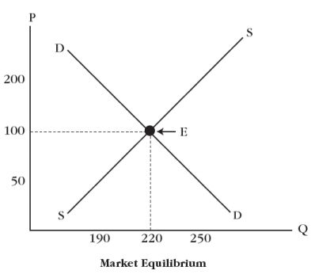
Memorize Drawing the graph.
1. Recite the alphabet to put the P and Q on the correct axis.
lmnoPQrstuvwxyz – P is to the left of Q
2. Demand goes Down.
3. Supply goes to the Sky.
Activity:
See how quickly you can draw it correctly.
Summary
There are some ways to remember how to draw the graph correctly.

Slide 75
Equilibrium

Slide 76
Learning Objectives Checklist
Equilibrium Price and Quantity
Disequilibrium
Surplus and Shortage
Change of Equilibrium
Double Shift Rule
Connected Markets
Resources affecting the Good
Goods affecting the Resource
Substitutes and Complements

Slide 77
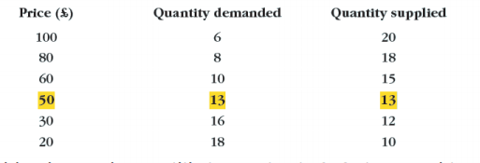
We can represent the demand schedule and supply schedule for a certain good.
Only at the price of $50 is the quantity demanded and the quantity supplied equal.
This is the equilibrium point.

Slide 78
What is meant by equilibrium price?
Equilibrium price is the price at which quantity demanded (Qd) is equal to quantity supplied (Qs)

Slide 79
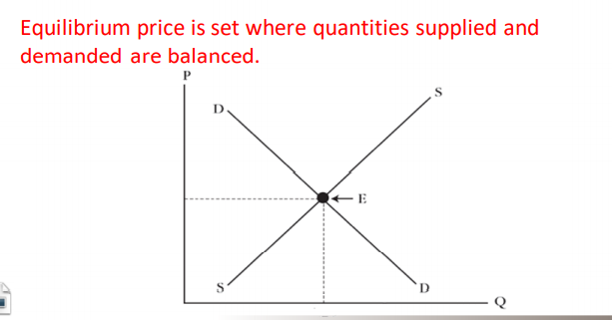
Use a fully labeled diagram to illustrate equilibrium. Make sure to label the equilibrium quantity Q_{E} and equilibrium price P_{E}
The equilibrium point, equilibrium price and equilibrium quantity are a ‘package’ that go together.
Equilibrium quantity corresponds to the Equilibrium price.
It is where Qd = Qs.

Slide 80
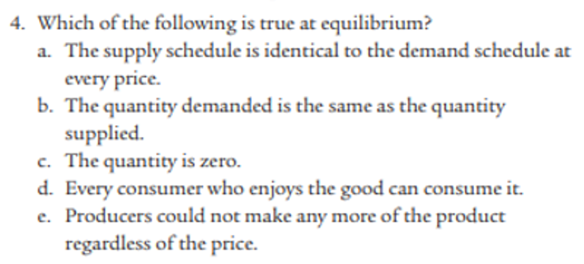
Answer: B because Qd = Qs at equilibrium

Slide 81
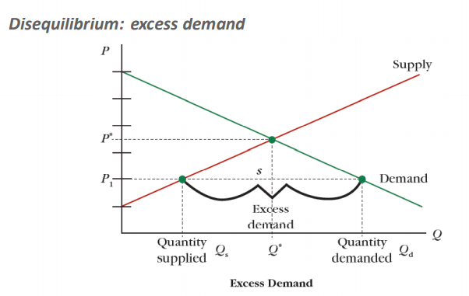
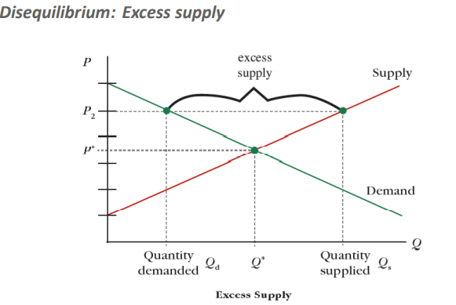
What happens when the price is too high or low?
Excess Supply - Surplus
Excess Demand - Shortage
Price too high
Price too low
There will be a shortage because many consumers will be willing to pay such a low price.
Suppliers won’t want to sell many units at this price.
As a result: The supplier will raise the price until they reach equilibrium.
There will be a surplus. Many products will remain unsold because suppliers want to sell at this price
However only a few consumers will want to pay this price.
The supplier will lower their price.

Slide 82
Price Mechanism
Excess Supply
Price too high
Price mechanism: Sellers will lower their prices.
In the case of excess supply, producers will not want to waste their production and will produce less and lower their price.
In the case of excess demand, producers will see they can sell more AND increase their prices and will do so accordingly.
Excess Demand
Price too low
Price mechanism: Sellers will increase their prices.
Summary
The Price Mechanism – suppliers will naturally change their prices to restore equilibrium

Slide 83
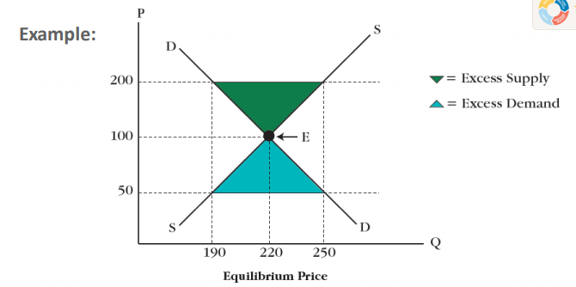
How does the price mechanism interferer to correct excess supply?
The price will decrease in the case of excess supply because of low demand. Suppliers will lower their price in order to match with consumer demand.
Using the diagram in the example above, calculate the excess demand when the price is set at 50 instead of 100. Show your calculation.
Excess demand = Qd – Qs = 250 – 190 = 60 units

Slide 84

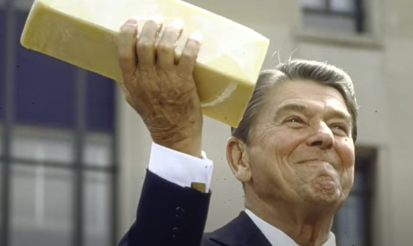
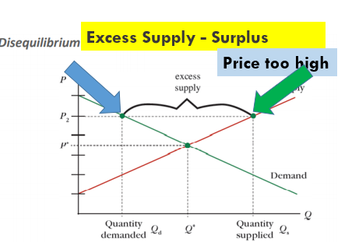
Historical Context: US Government Cheese
In an attempt to support the dairy industry (among others) in the United States, the government tried to stabilize prices, leading to an artificially high price for cheese.
Because the price would often be above the equilibrium, there was a resulting surplus of cheese.
The government then bought the surplus cheese, giving it as a part of their social welfare.
How Government Cheese Became Welfare For Farmers - YouTube

Slide 85
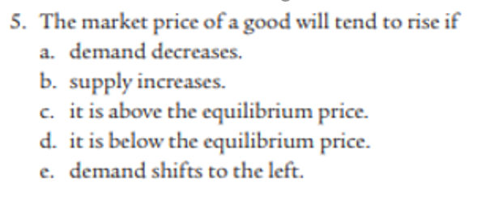
Answer: d)

Slide 86
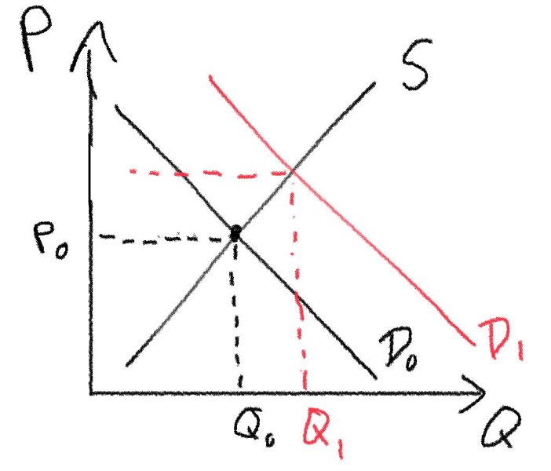
Changes in Equilibrium
The equilibrium point will always adjust to where demand and supply intersect.
Therefore, if there is any demand change or supply change it will create a new equilibrium point which is simply where the two curves intersect.
When we talk about a change in equilibrium point we should indicate changes to:
Price
Quantity
P₁
B
A
In the above example the change in demand moves us from:
Equilibrium point A to point B.
Price increased from P₀ to P₁
Quantity increased from Q₀ to Q₁
Summary
Equilibrium price and quantity can change if Demand or Supply changes.

Slide 87
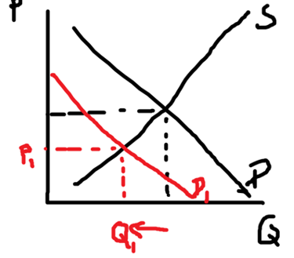
Show graphically the impact of the following changes in the market for chocolate boxes:
Consumers’ incomes rise by 20%.
Health studies show that chocolate consumption is bad for our teeth.
Price increases
Quantity increases
Price decreases
Quantity decreases

Slide 88
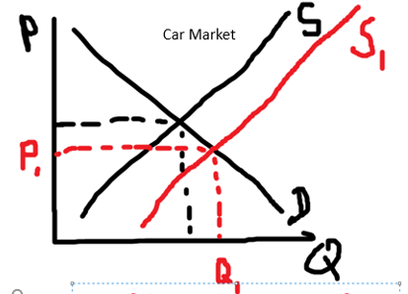
Questions
Indicate the new equilibrium position after a subsidy has been given to producers.

Slide 89
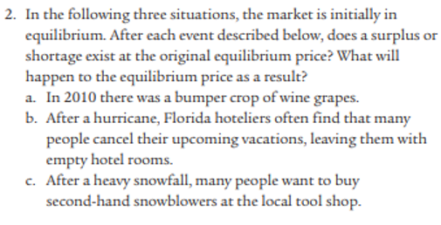
Module 6 Check Your Understanding
a) increase supply
At original price there will be a surplus – Qs > Qd
b) decrease in demand
At original price there will be a surplus – Qs > Qd
c) increase in demand
At original price there will be a shortage – Qd > Qs

Slide 90

Finish Module 6 Questions
D
B
D
D
C

Slide 91

Demand increase – price increases, quantity increases
Supply increase – price decreases, quantity increases
Demand decreases – price and quantity decreases

Slide 92




Slide 93

Double Shift Rule
Example
↑Demand → ↑Price, ↑Quantity
↑ Supply → ↓Price, ↑Quantity
So if we have a simultaneous increase of demand AND supply, we know for sure that the quantity is increasing but we can’t be sure about the price (without doing a lot of calculations).
A double shift is a situation where demand and supply curves move at the same time
A double shift (shift of demand and supply) will have an indeterminate effect on either price or quantity.
∆D
Price?
Quantity?
&
∆S
Summary
When D and S move simultaneously, P or Q will be difficult to easily see the change – ie. Indeterminate.
Double Shifts- Supply and Demand - YouTube

Slide 94




Double Shifts
Demand decreases, Supply Increases
↓ Demand → ↓ Price, ↓ Quantity
↑ Supply → ↓Price, ↑Quantity
Price definitely increases
Quantity Indeterminate
Demand Increase and Supply Increase
↑Demand → ↑Price, ↑Quantity
↑ Supply → ↓Price, ↑Quantity
Quantity definitely increases
Price Indeterminate
Demand decreases, Supply Decreases
↓ Demand → ↓ Price, ↓ Quantity
↓ Supply → ↑ Price, ↓ Quantity
Quantity definitely increases
Price Indeterminate
Demand Increases, Supply Decreases
↑Demand → ↑Price, ↑Quantity
↓ Supply → ↑ Price, ↓ Quantity
Price definitely increases
Quantity Indeterminate

Slide 95
What is the double shift rule?
If both demand and supply shift, then either the new price or new quantity will be indeterminate. (Indeterminate means it is hard to tell. Of course with more advanced maths we could tell but this is not in the AP Macro course.)

Slide 96
Indicate the new equilibrium position in the market for education after a subsidy has been given to producers and there has been a decrease in demand.
This is a double shift, so either the new quantity or new price will be indeterminate.
In this case, the price would definitely change but the quantity would be indeterminate.

Slide 97
Suppose the population grows which would increase the number of workers and also the number of consumers for phones. Which of the following would occur in the market for phones?
Equilibrium price would increase.
Equilibrium quantity would increase
Equilibrium quantity supplied would increase.
I only.
II only.
III only.
I and II only.
I, II, and III.
II and III
Answer:
II and III

Slide 98
How Markets Are Connected

Slide 99





Effects Across markets
Summary
A good can be affected by other markets when it involves substitutes/complements or resources.
The market for a good is not isolated from events that occur in other markets.
This true for substitutes and complements eg. Coke and Pepsi (subst) or guns and bullets (complmements)
It is also true when goods are used for other goods.
Eg. Wood is used to make furniture
Sand is used to make silicon, silicon is used to make computer chips, chips are used to make computers.
We can draw multiple market graphs to show these effects.
Changes to the market for Cola will have an effect on Pepsi.
Example:
Lithium is needed to produce lithium ion batteries which are in phones, computers, cars etc.
What happens if there is a discovery of lithium in South America? What is the effect on the market for phones? Increase in supply of phones.

Slide 100

Market for Lithium
Market for Phones
A discovery of lithium increases the supply of lithium
Lithium is an input for batteries, there will be an increase in the supply of batteries
Batteries are an input for phones.
Therefore there will be an increase in the supply of phones that creates a new equilibrium.
Market for Batteries
Mobile Phones
In this case I would only recommend to draw the market for phones! (though you won’t be punished for drawing all)
Discovery lithium ↑Supply_{lithium}→
↑Supply_{batteries}→
↑Supply_{phones}→
New Equilibrium Market for Phones:
↑Quantity
↓Price
Summary
The example shows how changes to inputs/resources used for a product affect that product.

Slide 101



Demand for a Good Affecting the Resource
Resources can affect the market for a final good but the final good can also affect the resource!
Eg. Increased demand for coffee will increase demand for coffee beans.
Eg. A decrease in the production of pizza due to worker shortage will lead to less demand for cheese.
Market for Coffee
Market for Coffee Beans
Market for Pizzas
Market for Cheese
Summary
Goods can also affect the market for their resources.

Slide 102
Market for Coke
Market for Pepsi
A contamination scandal at one of the coke factories causes a decrease of demand for coke to decrease, and fewer people buy coke.
Customers who would buy coke usually shift to Pepsi, increasing demand and quantity demanded.
Summary
Substitutes and complements can cause effects across markets.

Slide 103




Cross Market Summary
Substitutes and Complements
Resources affecting the Good
Usually affects Supply
Goods affecting the Resource
Usually affects Demand
Mobile Phones

Slide 104
What are the two main types of effects from other markets that can affect a good? Give examples of each.
Substitutes and Complements
Substitute eg.: Coke and Pepsi
Complement eg.: Gasoline and gasoline cars.
Resources
Eg. A shortage of computer chips affects the phone market
Eg. Many people young engineers leave the country, affecting the supply of cars in the country which then affects the demand for steel.

Slide 105



Question
A forest fire affects cedar and oak trees which are used to produce wooden barrels. These barrels are also used in the production of expensive wine. What happens to the equilibrium in the market for expensive wine?
↓Supply oak wood →
↓Supply oak barrels →
↓Supply expensive wine →
New Equilibrium: (↑Price wine, ↓ Quantity wine)

Slide 106

Question
A forest fire affects cedar and oak trees which are used to produce wooden barrels. These barrels are also used in the production of expensive wine. What happens to the equilibrium in the market for expensive wine? What is the effect on the market for beer?
↓Supply oak wood → ↓Supply oak barrels → ↓Supply expensive wine → New Equilibrium: (↑Price wine, ↓ Quantity wine)
Because wine is a substitute for beer,
↑Price wine → ↑Demand for beer → New Equilibrium : (↑Price beer, ↑ Quantity beer)
Note: We have looked at 4 markets in this question. At each step, think about the effect on the next market.
Market for Wine
Market for Beer

Slide 107
Equilibrium Questions – Multiple Markets
1. The government gives a subsidy to producers of steel. Effect on the car industry?
2 A study shows the benefits of red wine. Effect on the beer market?
3 A global pandemic makes it harder for people to attend movie theatres and live shows. Effect on the market for home video streaming services?
4 A shortage of computer chips makes laptops more expensive. Effect on the market for Microsoft Windows software?
5 The airline industry sees an increase in ticket sales. Effect on production of plastic goods such as kid’s toys?

Slide 108

Question 1
Increase in supply in steel market
Causes Increase in supply in car market
↑Quantity ↓Price
increasing
Question Home

Slide 109

Question 2
Increase in demand for wine
Causes a decrease in the demand for beer (which is a substitute)
Question Home

Slide 110

Question 3
Which causes an increase in Home streaming (iQiyi) (a substitute)
The market for live shows decreases
Question Home

Slide 111

Question 4
The shortage of chips (which is an input) causes a decrease in supply of laptops
↓ Quantity ↑ Price
Because people are buying less laptops, there is less demand for software (a complement)
↓ Quantity ↓ Price
Question Home

Slide 112

Question 5
Demand for flights has increased
Jet Fuel is an input for flights and so demand for jet fuel will increase
↑Quantity
Oil is used for jet fuel
Oil is also used for plastic toys
Because more oil is used to make jet fuel, less plastic toys will be made (substitutes of production)
↓ Quantity ↑ Price
Question Home

